Slide 1

Exercise is Medicine: A Global Health Initiative
Notes:
EIM, which is hosted by ACSM, was first started in 2007 and we are now entering seven and a half years developing and spreading the program globally. But before I share with you the program, I briefly want to describe the situation that led ACSM to start this initiative…

Slide 2
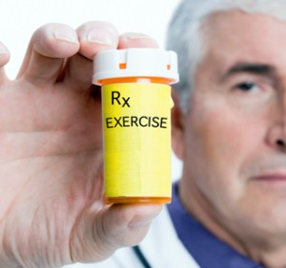
If exercise could be packed in a pill, it would be the single most widely prescribed and beneficial medicine in the nation.
Robert N. Butler, M.D.
Former Director,
National Institute on Aging
Notes:
First, I’d like to start out with the words of Dr. Robert Butler, the former director of the National Institute of Aging. He stated, as many of us believe, that “If…” However, exercise is not packed in a single pill and so we are left with the challenge of trying to develop strategies that engage the public in greater levels of physical activity.

Slide 3
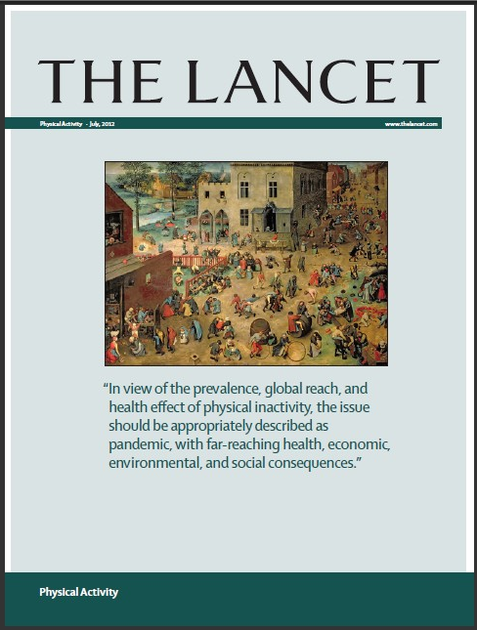
“In view of the prevalence, global reach and
health effect of physical inactivity, the issue
should be appropriately described as
pandemic, with far-reaching health, economic,
environmental and social consequences.”
July 2012
Notes:
Supporting this notion, in 2012, the British journal “The Lancet” released a special issue on Physical Activity. Among their many conclusions was this statement warning of the….

Slide 4
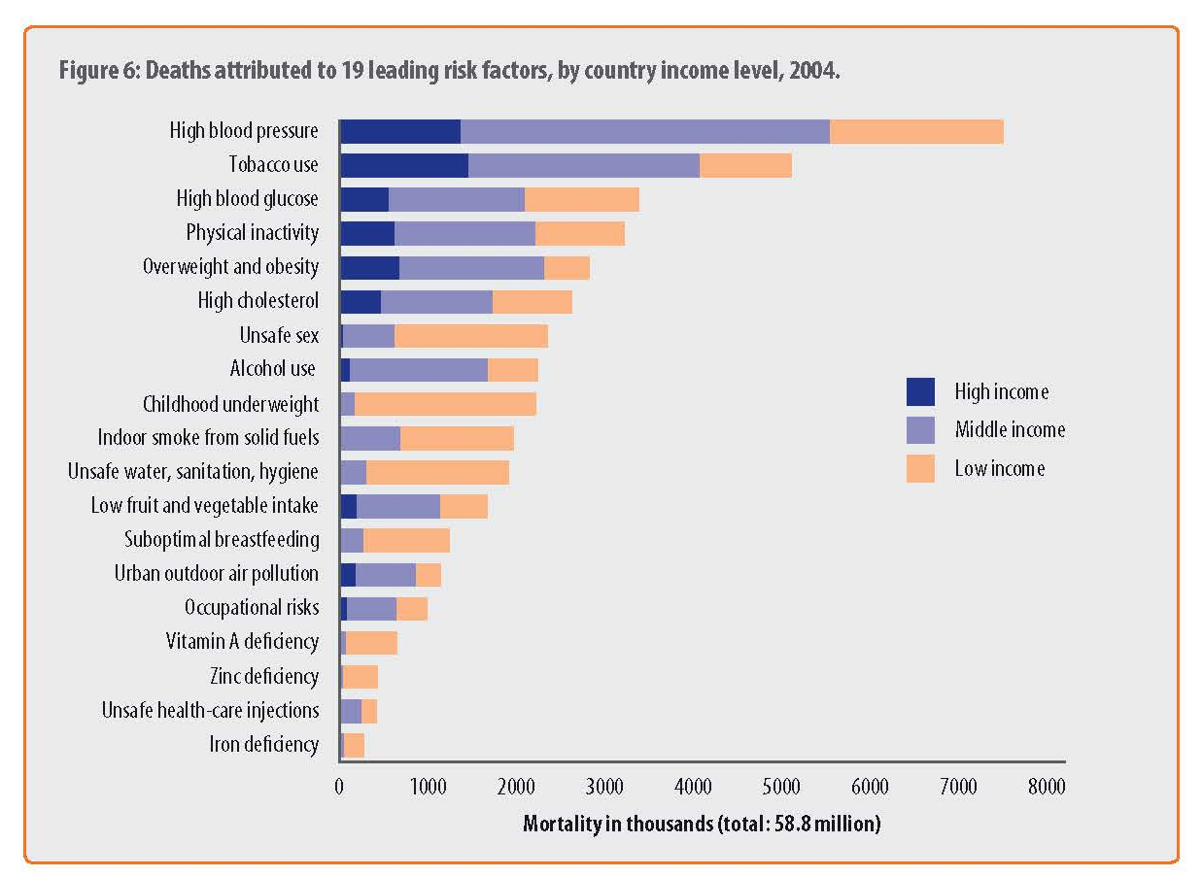

Global Epidemic of Inactivity
WHO. Global health risks: mortality and burden of disease attributable to selected major risks. 2009. http://www.who.int/healthinfo/global_burden_disease/GlobalHealthRisks_report_full.

Slide 5
Leading Causes of Death in the U.S.
The 15 leading causes of death in 2013 were:
1. Heart Disease
2. Malignant neoplasms (cancer)
3. Chronic lower respiratory diseases
4. Cerebrovascular diseases (stroke)
5. Accidents (unintentional injuries)
6. Alzheimer’s disease
7. Diabetes
8. Nephritis, nephrotic syndrome and nephrosis (kidney disease)
9. Influenza and pneumonia
10. Intentional self-harm (suicide)
11. Septicemia
12. Chronic liver disease and cirrhosis
13. Essential hypertension and hypertensive renal disease
14. Parkinson’s disease
15. Pneumonitis due to solids and liquids
Physical INACTIVITY related diseases

Slide 6
Cardiorespiratory Fitness & Mortality
All-Cause Death Rates by CRF Categories –
3,120 Women and 10,224 Men
Blair SN. JAMA 1989
Notes:
This work was followed by many other prominent scientists in the field – among them Dr. Blair and his team who have repetitively shown that higher levels of cardiorespiratory fitness are associated with decrease levels of mortality.

Slide 7
Effect of CRF on Mortality Attributable Fractions (%) for All-Cause Deaths
40,842 men & 12,943 women from the Aerobic Cooper Longitudinal Study
Blair SN. Br J Sports Med 2009; 43:1-2.
Notes:
When looking at the percentage that different risk factors contribute to mortality, a low level of cardiorespiratory fitness exposes an individual to a greater risk of dying than does smoking, obesity, hypertension, or high cholesterol – all risk factors that have traditionally received greater attention from physicians and the medical field.

Slide 8
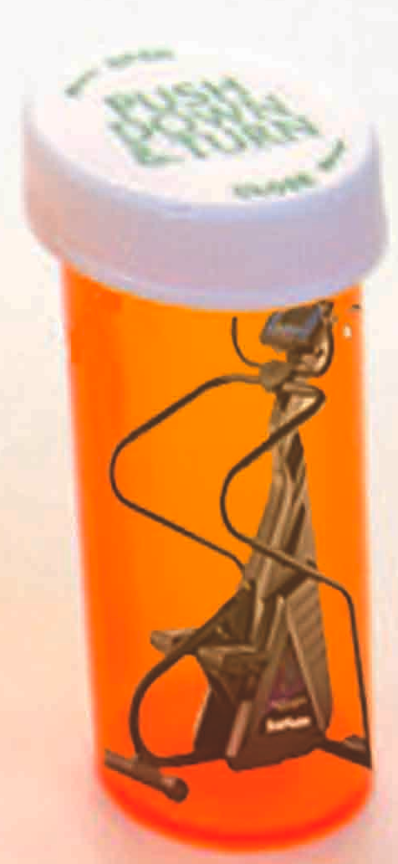
Exercise is a Medicine Physicians should prescribe it, Patients should take it!
Instead of an allergy, exercise may be the long sought vaccine to prevent chronic disease and extend life
Are we reaching a point where NOT prescribing physical activity should be consider patient neglect?
Notes:
As the evidence has continued to mount about the health detriments of being physically inactive, it has become clear that exercise is a “medicine” – a vaccine that can prevent multiple chronic and mental diseases, as well as improve and extend our quality of life.
Therefore, we have come to the point where we are now asking ourselves - ….

Slide 9
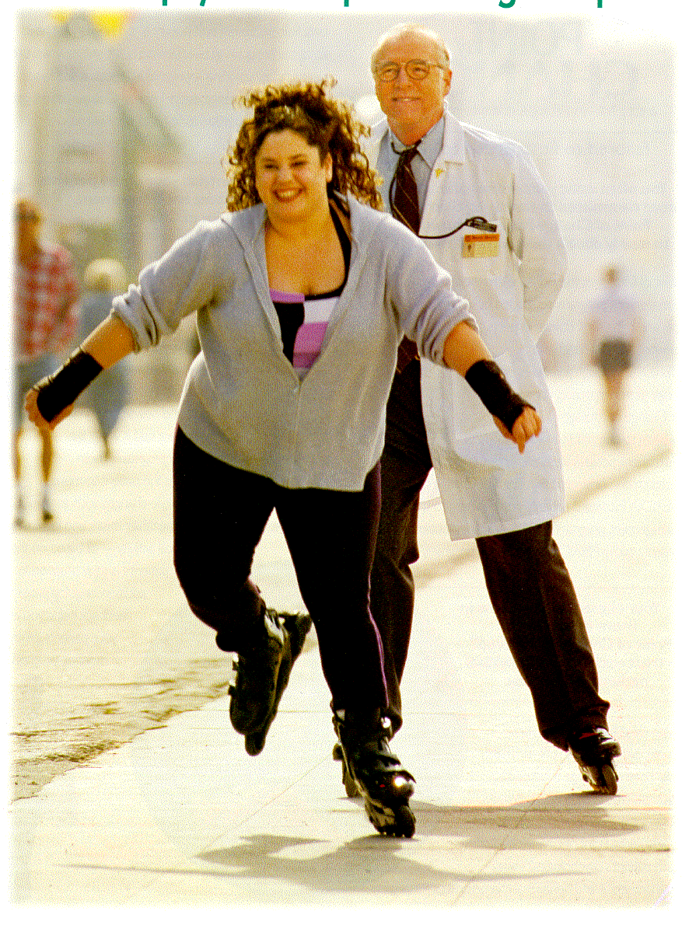
Do You Really Think We have a Chance Without Exercise?
Obesity
Coronary artery disease
Diabetes
Hypertension
Cancer
Depression and anxiety
Arthritis
Osteoporosis
Etc, etc, etc…
Patients
Physicians
NO!
Notes:
EIM takes the position that to make exercise a “pill” that every patient takes, physicians and their healthcare teams must play a major role in helping encourage and support their patients in becoming more physically active!

Slide 10


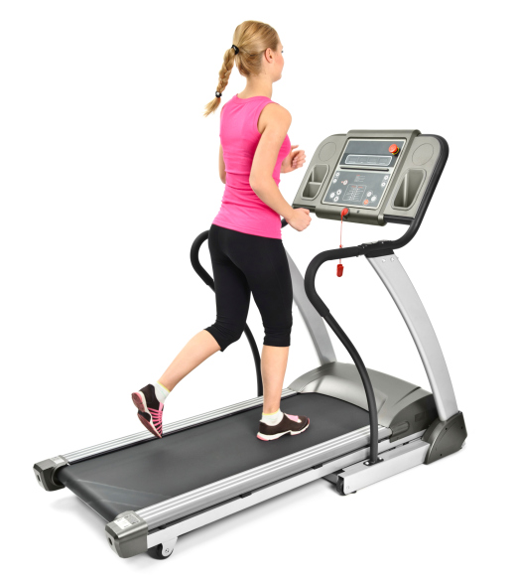
We have to get people moving
Regularly Active
Out of the chair & off the couch
Engaged in an
Active, Healthy
Lifestyle

Slide 11
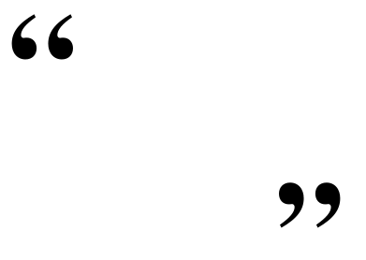

What if there was
one prescription
that could
prevent and treat
dozens of diseases,
such as diabetes, hypertension and obesity…
Would you prescribe it to your patients?
Certainly!
- Robert E. Sallis, M.D., FACSM,
EIM Global Center Chairman

Slide 12
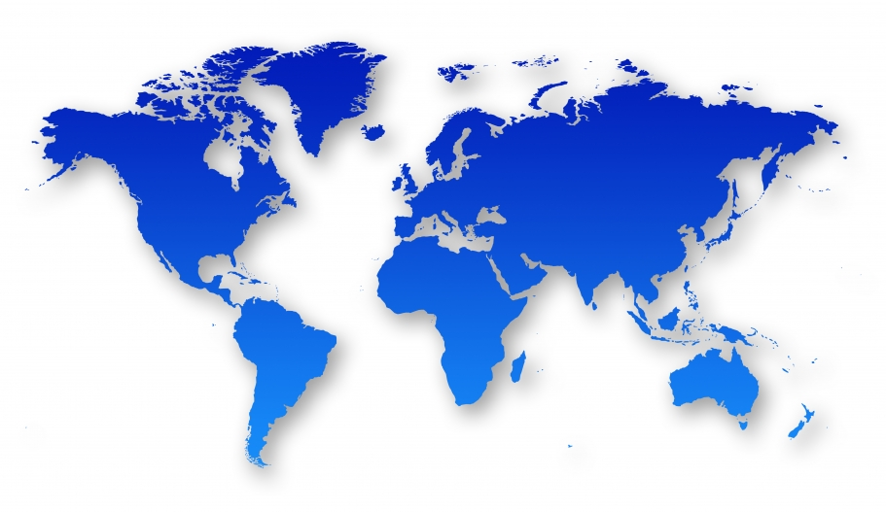

Exercise is Medicine® is a global initiative to establish physical activity as a standard in healthcare.
EIM’s Goal is Transformational Change
To institutionalize physical activity assessment & prescription into Global Healthcare Systems
Notes:
EIM was launched in 2007 by the American College of Sports Medicine and quickly thereafter became a global initiative. It is important to note that the goal of EIM is to make systematic change – to impact population health through changing entire healthcare systems and not just of one medical office at a time.

Slide 13
Exercise is Medicine (EIM) Global Health Initiative Presence
Canada
Norway
Sweden
Russia
UK
Germany
Czech Republic
Switzerland
Slovakia
USA
Portugal
Spain
Hungary
Turkey
China
Israel
Lebanon
Jordan
Kuwait
Mexico
Puerto Rico
UAE
Aruba
Qatar
Thailand
Philippines
Costa Rica
Venezuela
Malaysia
Colombia
Ghana
Kenya
Singapore
Ecuador
Indonesia
Brazil
Key
No EIM presence
EIM presence
EIM Regional Centers
Paraguay
Chile
Australia
Uruguay
South Africa
Argentina
Notes:
GMARK Ltd. Grants Purchasing Customers With a License to Use This Product Under the Following Conditions.
Definitions
‘Product’ is defined as the PowerPoint file whose product name is ‘Interactive World Map’
‘Customers’ are individuals or individuals representing an organisation who have purchased a license from InteractivePowerPointMaps.com
License Grant
Customers may provide all employees within all of their your business locations products purchased from InteractivePowerPointMaps.com
Customers may freely edit the PowerPoint file which includes deleting objects, changing colours, rescaling and any other editing function available within PowerPoint.
Customers may use the product in part or in whole within presentations that may be sent to 3rd parties, so long as you are not charging them (see Usage Rights #2).
Customers may freely use the product in public places such as trade show kiosks and other multimedia displays but may not give copies of the product away in quantities greater than 10 units per day unless you credit the source as originating from InteractivePowerPointMaps.com in which case you may circulate an unlimited quantity.
Usage Rights
The original product remains Copyright © GMARK Ltd., a company registered in the UK and regulated by the Laws of England.
As a licensee, Customers are not permitted to resell, loan or rent the purchased products.
Customers are also not permitted to transfer the usage rights of the purchased products in return for payment or free of charge to third parties.
Customers are not permitted to translate, in part or in whole, the content of the product.
Copies may be kept on non-public storage and you may not store the product on public Web servers.
Rights include all electronic, printed and reproduction, including;
* Presentations and hand outs with unlimited circulation * Use of print media such as brochures, flyers as well as illustrations * Storage of the services, products and templates on the intranet server and / or network
Changes To These Conditions
From time to time, we may change our terms and conditions and the most up to date copy of these conditions is published on our Web site at http://www.InteractivePowerPointMaps.com/license

Slide 14
The Exercise is Medicine® Solution
Three basic modules are necessary to establish physical activity as a standard in healthcare
EIM Solution
Healthcare Systems
Community Resources
Active Health Technology

Slide 15

Health Care Providers adopt the EIM Solution by integrating and implementing the clinician module(steps 1-3)
EIM Solution
Healthcare Systems
Community Resources
Active Health Technology

Slide 16

Healthcare Systems
Use the clinician module (steps 1-3) to promote physical activity to patients
1. Physical Activity Assessment
Clinicians and their healthcare team assess physical activity levels during every patient visits.
2. Physical Activity Prescription
Utilization of simple, fast, and effective tools for prescribing physical activity in the right “dose” for the prevention, treatment and management of chronic medical conditions.
3. Referral to a Physical Activity Network
Providing a list of programs, places, and professionals that offer the patient a selection of options that meet their individual needs and personal preferences to fill their physical activity prescription.

Slide 17


Healthcare Systems
1. Physical Activity Assessment
Healthcare professionals initiate a conversation about physical activity by assessing their current activity levels
Physical activity can be quickly and efficiently assessed in the clinic setting through the use of the Physical Activity Vital Sign (PAVS).
The PAVS is a simple 2 item questionnaire that can determine weekly minutes of moderate intensity physical activity.
Healthcare teams can then assess whether patients are meeting national physical activity recommendations and adjust their treatment accordingly.
The PAVS is most effective when embedded as a “vital sign” in the electronic medical record (EMR).

Slide 18
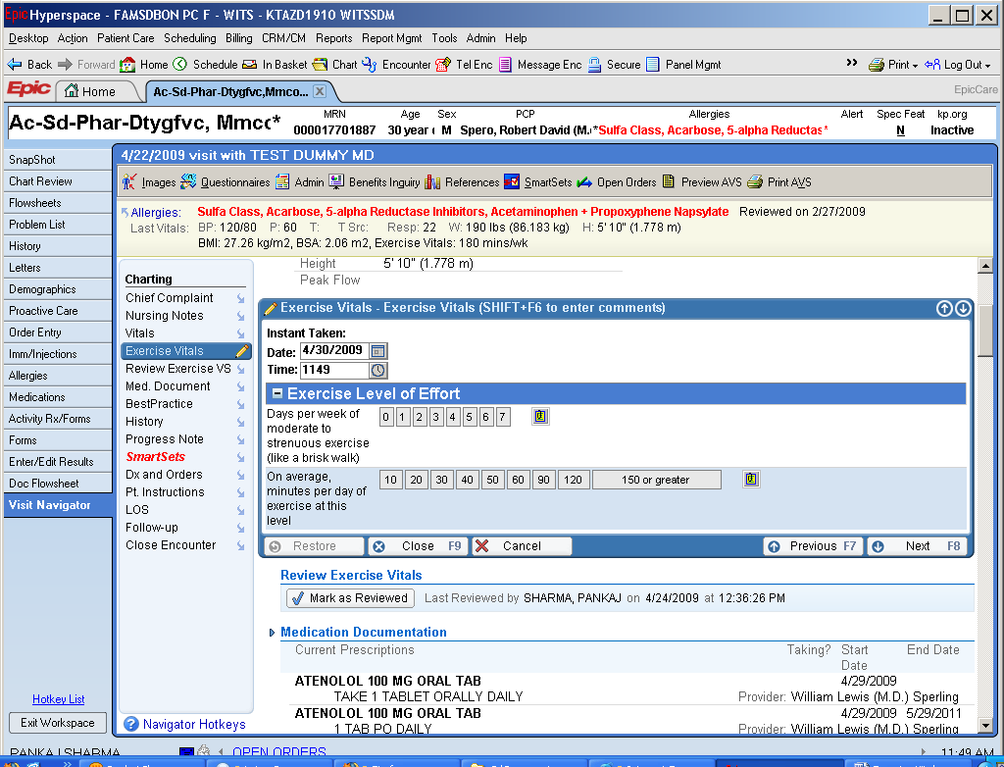
Notes:
An example of the PAVS embedded into the electronic medical record within a healthcare system. The red boxes outline the two items from the PAVS questionnaire. They are then multiplied to provide a total level of weekly physical activity (yellow oval) that can be compared to national physical activity guidelines.

Slide 19

Healthcare Systems
2. Physical Activity Prescription
Healthcare professionals provide their patients with a prescription as a first step in promoting physical activity to their patient
Using the results from the PAVS, healthcare providers can provide the patient with an appropriate physical activity prescription.
Physical activity prescriptions are based on both identified health risks and American College of Sports Medicine (ACSM) evidence-based guidelines.
Prescriptions can be provided to each patient through the use of EIM prescription pads or web-based tools.
Prescriptions can then be filled through referral to existing community resources.

Slide 20
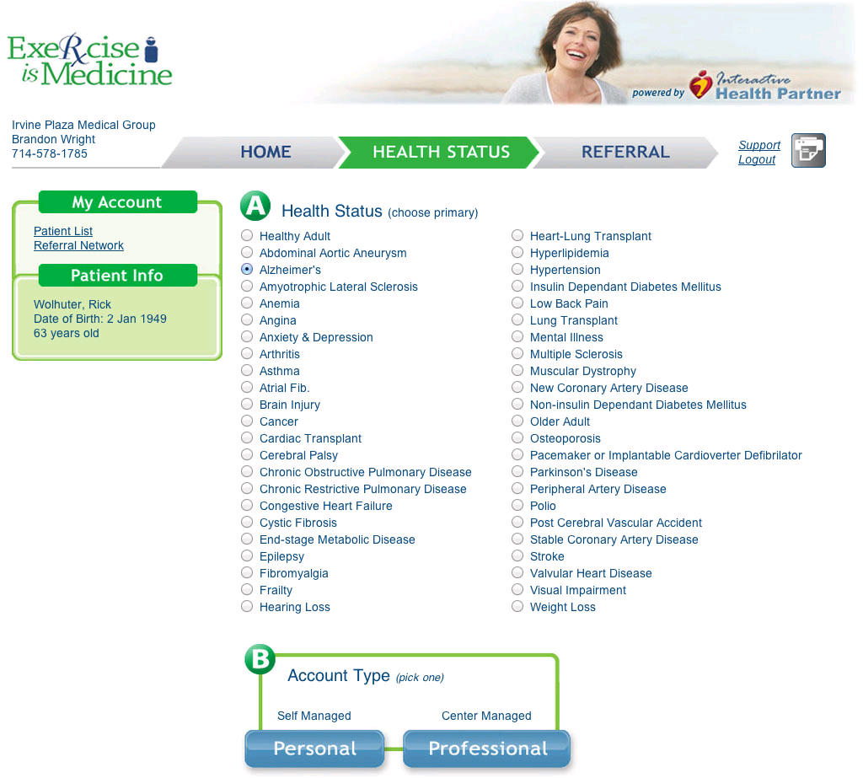

An Electronic Physical Activity Prescription Tool
Notes:
Pictured above is an example of a web-based tool that can be used to provide patients with a more individualized PA prescription based on their medical condition. Once a healthcare provider selects the appropriate disease condition (such as the onset of Alzheimer’s disease as pictured above), a exercise guide can be quickly printed out to provide the patient with additional information (i.e., risks and contraindications) on exercising with their current medical condition(s).

Slide 21
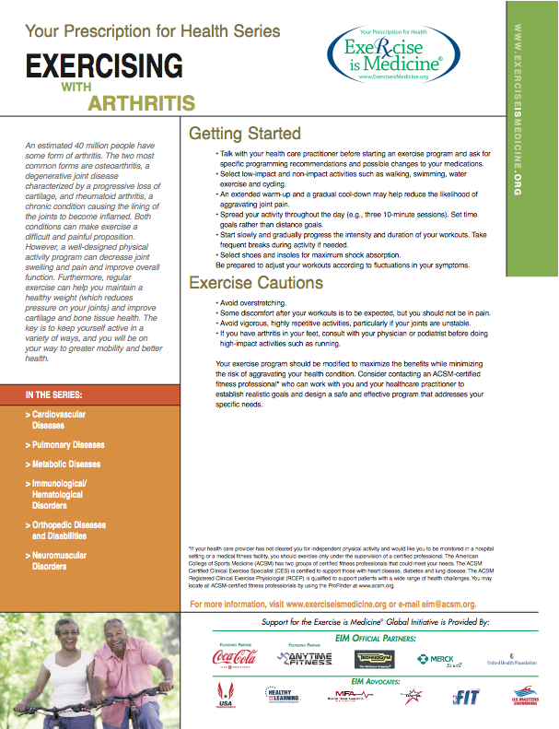
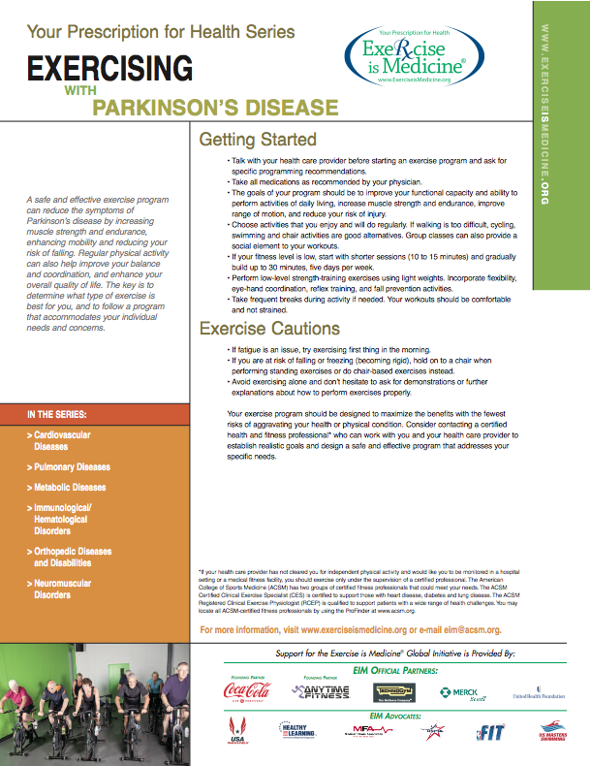
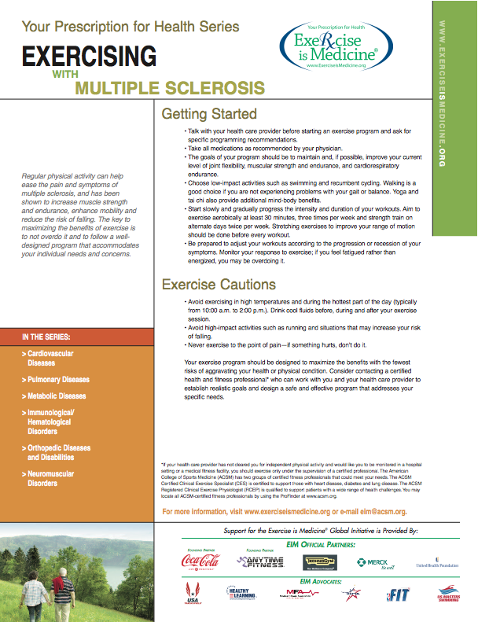
Your Prescription for Health Series
Notes:
Shown above are examples of 3 exercise prescriptions for different medical conditions (arthritis, multiple sclerosis, and parkinson’s disease). EIM has created 45 different patient education handouts that discuss exercise with various health conditions.

Slide 22

Healthcare Systems
3. Physical Activity Referral Healthcare teams refer their patients to existing resources to support their efforts to become more active.
Healthcare providers help their patients fill their exercise prescription by referring them to existing community resources.
This may include directing patients to self-managed physical activity programs that can be performed independently.
Other patients may need more structured programs that meet their individual health risks, abilities, and environmental needs.
Existing community resources, such as certified programs, conducted at recognized places, hosted by credentialed professionals, may better engage patients in lifestyle modification strategies.

Slide 23
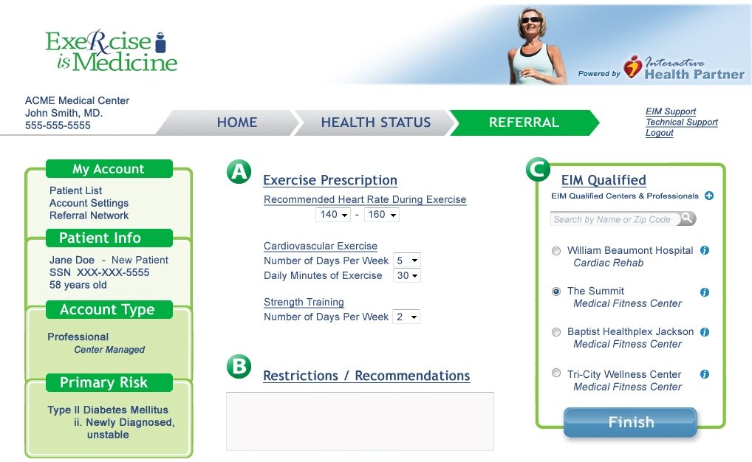

Referrals to qualified PA programs delivered by credentialed EIM Professionals at EIM recognized places
Notes:
In providing an physical activity referral to their patients, healthcare providers may wish to develop a referral network of local community resources (programs, places, and professionals – described in the next section) that they can quickly and easily access. Through this database, they can then provider a list of community resources to help their patient become more physically active.
Above is an example of a web-based tool that collects a database of EIM certified programs, places, and professionals that a healthcare provider can access and provide to their patients.

Slide 24

Clinic - END GOAL
No patient should leave a physician’s practice without:
An assessment of their current physical activity levels
- and -
A physical activity prescription and referral to
qualified resources for further counseling.
Notes:
Suggested Talking Points

Slide 25
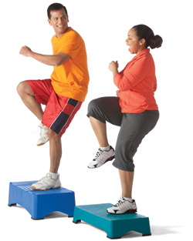
Existing Community Resources are utilized to support patients in increasing their physical activity levels (step 4).
EIM Solution
Healthcare Systems
Community Resources
Active Health Technology

Slide 26
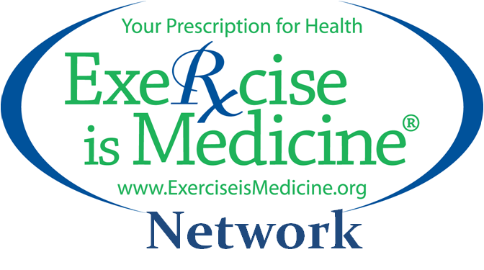

Community Resources
4. Establishing a Physical Activity Referral Network
Providing patients with convenient, local access to credentialed EIM Professionals, EIM qualified PA Programs and EIM recognized Places
Utilizing existing community resources to create a physical activity referral network to serve at-risk community population groups including those who suffer from obesity, sedentary lifestyles, and may have chronic diseases and conditions.
Training professionals in the community and developing specialized programs to provide assistance for referred patient.
Serving as a trusted referral source to which healthcare providers can send their at-risk patients.

Slide 27

PA Intervention Advisors
The role of the PA Intervention Advisor is to serve as a link – a middle person - between the healthcare team and the existing community resources
Some systems may not have or use PA intervention advisors, but these professionals can serve as key “links” encouraging patients to follow through on their “prescription”
PA intervention advisors may also be particularly useful in engaging hard-to-reach, at-risk patients and empowering them to be more physically active

Slide 28
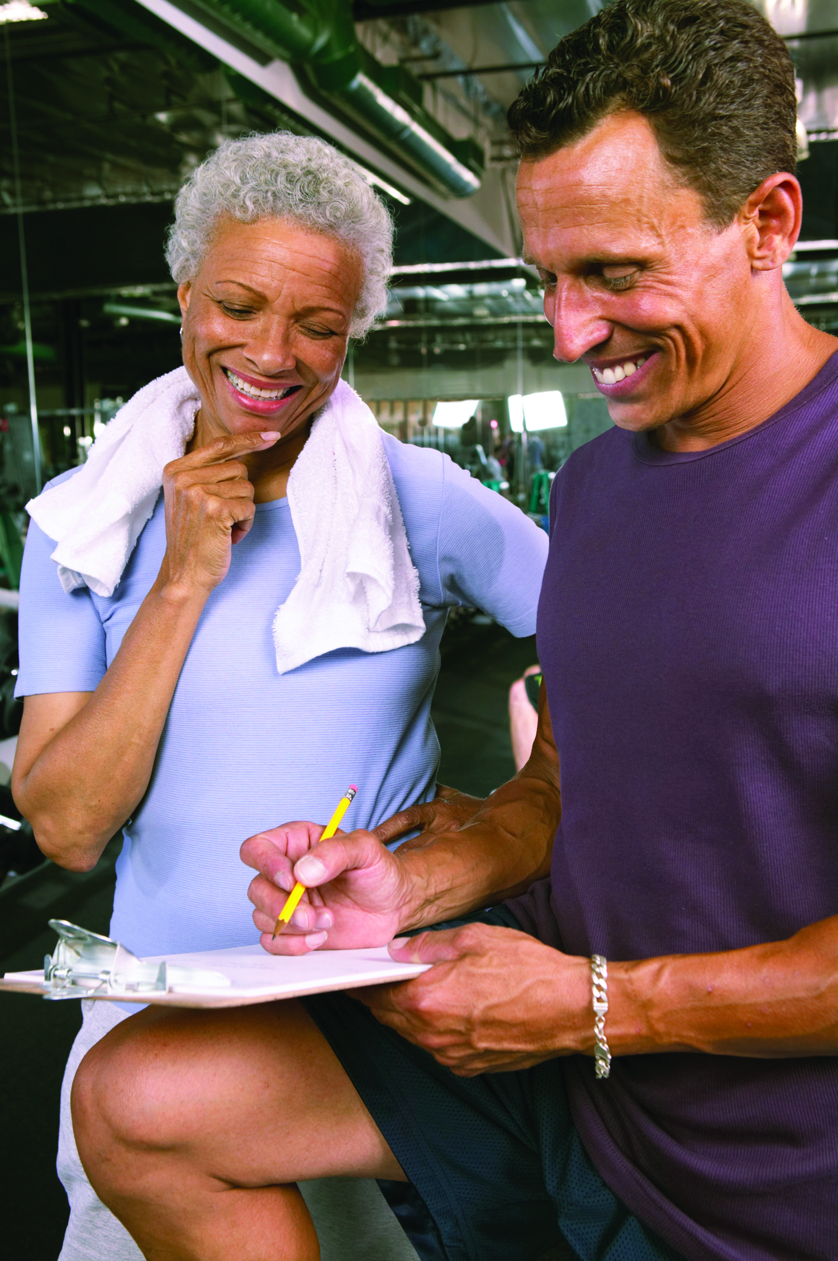
Credentialed EIM Professionals
Certification of exercise and fitness professionals who are trained to work with at-risk populations
Trained to deliver multi-faceted physical activity programs that include structured physical activity, as we all as lifestyle modification strategies
May also support self-management programs
Credentialed to work with either low, moderate, or high risk patients to meet the high standards required by healthcare providers and payers

Slide 29
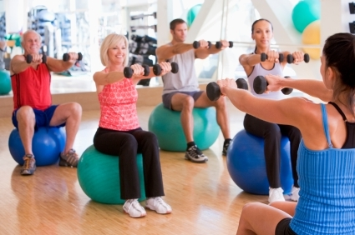
Qualified PA Intervention Programs
Structured PA, health education and lifestyle change strategies designed that:
Prevent and manage non-communicable chronic diseases
Combat obesity and sedentary lifestyles
Extend therapeutic and rehabilitative care
Notes:
Engaging muscle and mind in a group and/or self-directed PA Intervention Programs.

Slide 30

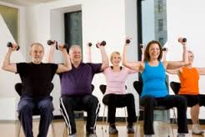

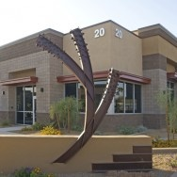
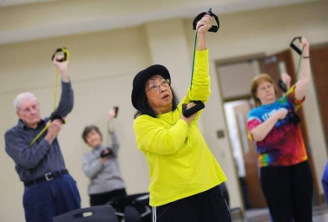
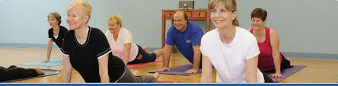
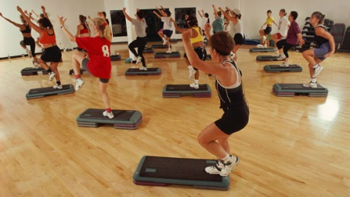
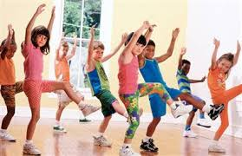
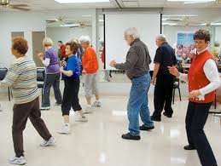
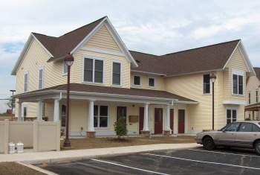
Recognized EIM Places
Safe and convenient locations in the community for at-risk population groups to participate in PA programs
Municipal Community Centers
Park & Recreational Facilities
Hospital Wellness Centers
Medical Fitness Facilities
YMCA Facility Locations
Physical Therapy Clinics
Commercial Health Clubs
School System Facilities
Corporate Health Centers
Other Appropriate Spaces
Notes:
A community-based network featuring a variety of places to experience PA Intervention Programs provide access to meet all preferences and help lower barriers to sustained participation.

Slide 31


EIM Solution = Building a Bridge of Trust between Healthcare Stakeholders and Community Resources
Notes:
Building a bridge of Trust by applying the EIM Solution to Healthcare Stakeholders and Community Resources for Referrals to experience a seamless patient-centered care transition from the Clinical Care Team to the Community Care Team.

Slide 32
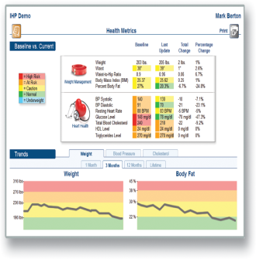
Active Health Outcomes uses the power of technology for tracking participation, conducting assessments and reporting (step 5)
EIM Solution
Healthcare Systems
Community Resources
Active Health Technology

Slide 33

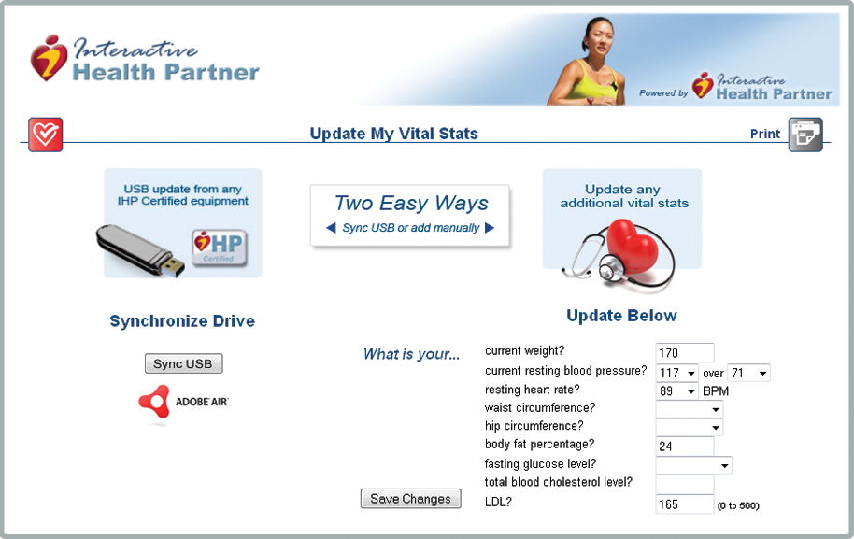
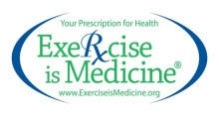

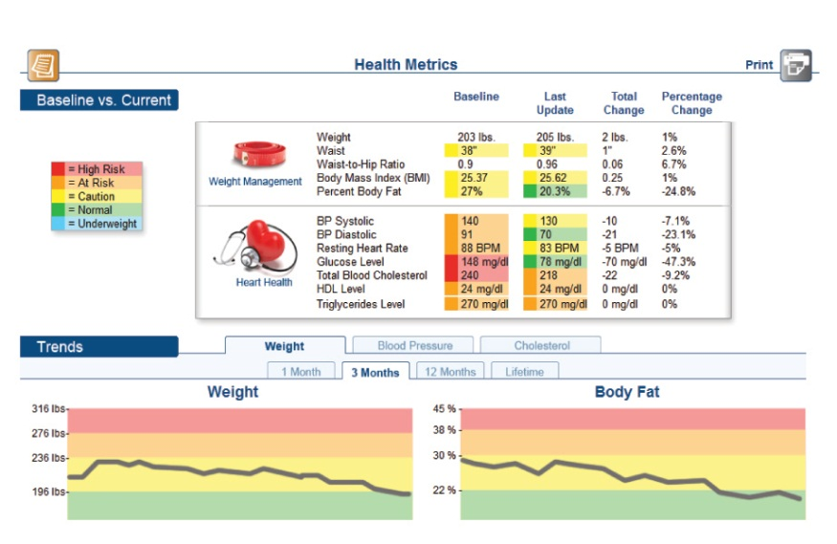
Active Health Technology
Collecting PA program participation data using web applications and tablets
EIM Solution: Utilizing Technology
Armed with leading edge technology, EIM Professionals effectively deliver PA programs, promote and track participation, conduct assessments and report measurable individual and aggregate outcomes

Slide 34


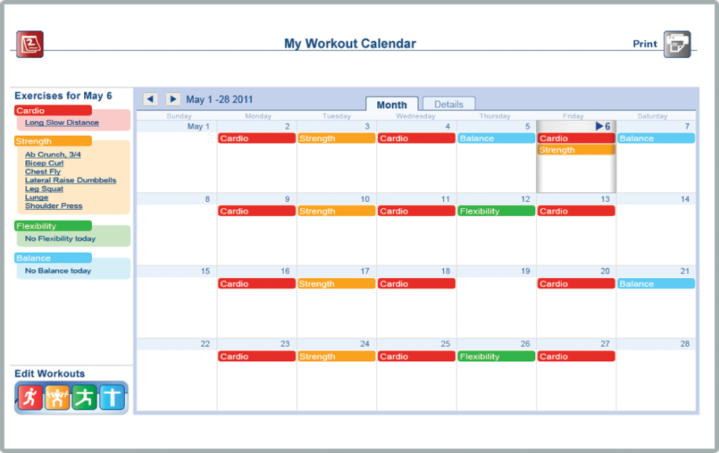
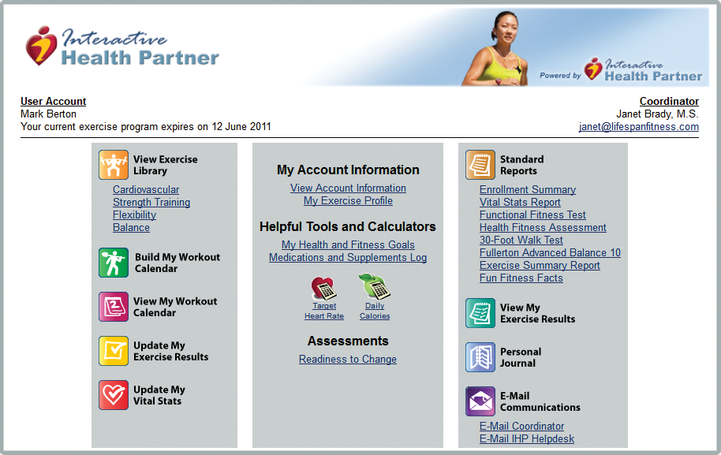

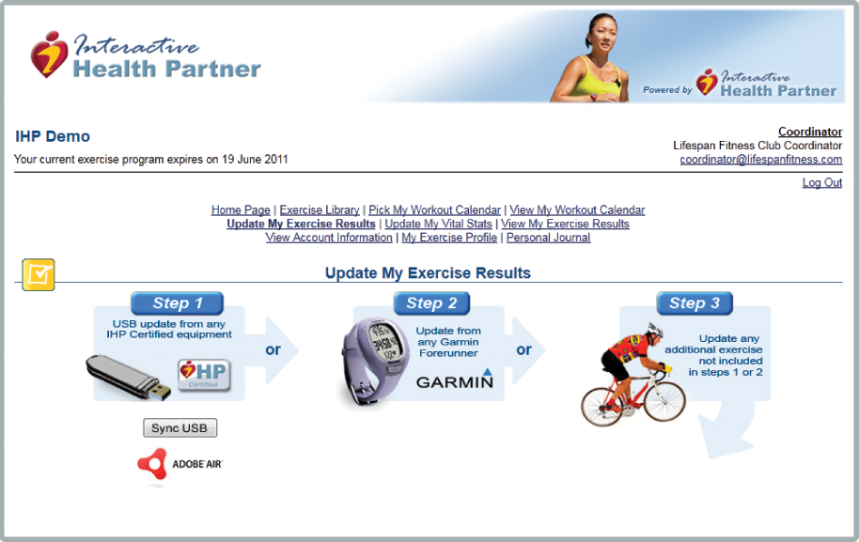









Active Health Outcomes
Usable, clear,
easy-to-read graphs and charts showing outcome analytics that link back to the health care provider enable educated decisions concerning participation in physical activity programs.

Slide 35
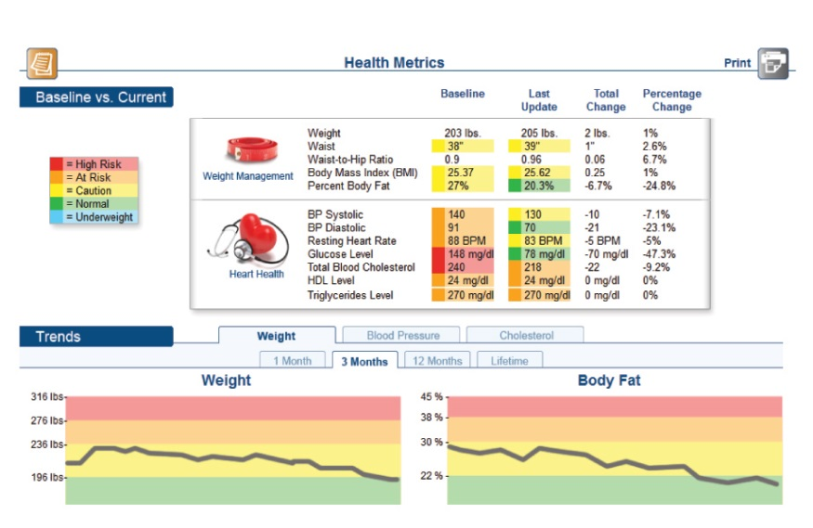
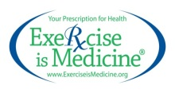

Active Health IT
Usable, clear, easy-to-read graphs and charts showing outcome analytics that link back to the health care provider enable educated decisions concerning participation in PA programs.
Enrollment
Prescription
Referral
Delivery
Participation
Assessments
Collection
Outcomes
Active Health IT Platform (engagement to outcomes)

Slide 36
Healthcare Providers Physical Activity assessment and prescription & direct patients to the EIM Network
The EIM Solution: A Comprehensive Model
Intervention Advisors/Navigators assist patients with:
Enrollment
Assess Readiness
EIM Prescription
EIM Referral
Qualified PA Intervention Programs delivered at recognized Places by credentialed EIM Professionals
Healthcare Payers reimburse eligible patients, employees & beneficiaries to participate in the EIM Network
Transition Engagement
EIM impacts Public Health by assisting the underserved to participate in the EIM Network
EIM Network
Shared by Providers, Payers and Public Health to provide a critical mass of community participation in PA programs
Active Health IT Platform (engagement to outcomes)

Slide 37

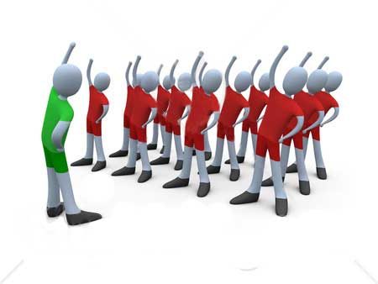
The EIM Solution
The EIM Solution begins with the engagement of Healthcare Providers and Payers sending at-risk Populations to an EIM Network for participation in culturally-adapted, specialized physical activity intervention programs.
Notes:
The EIM Solution establishes physical activity as a standard in healthcare as a cost containment strategy by providing PA Intervention Program access as an extension to healthcare through a shared delivery network.

